Slide 1


E-comm database
Project-3
Made by-Pulkit

Slide 2
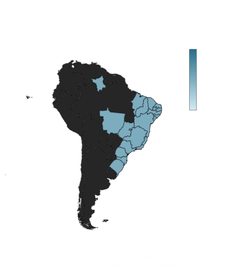
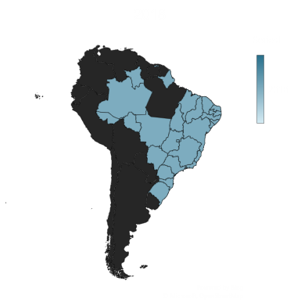
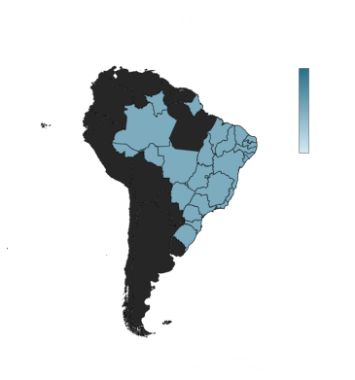
Customer acquisition over the years
Total
329
45,101
54011

Slide 3
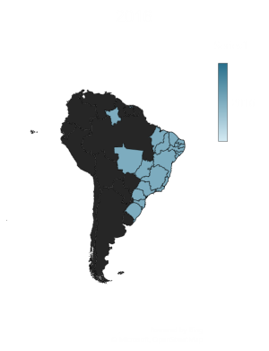
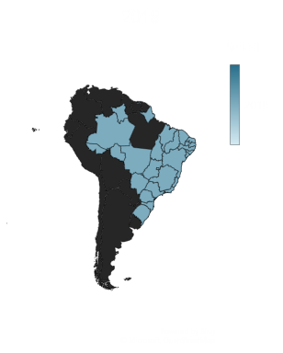
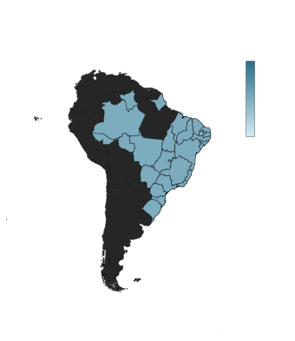
Total no. of orders over the year
Total
329
45101
54011

Slide 4
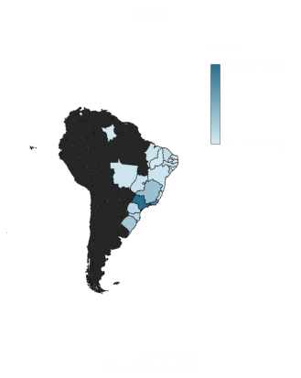
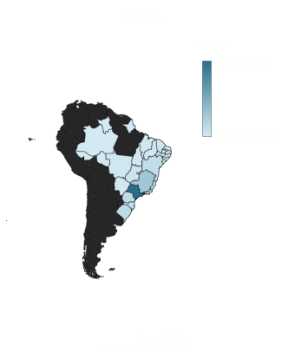
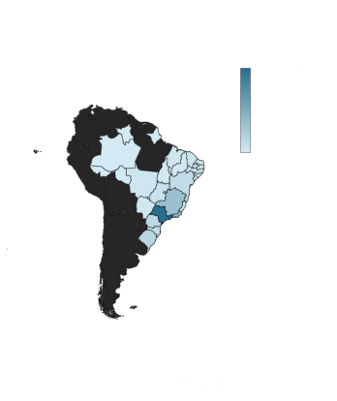
Total number of sales over the year
Total
59,362
72,49,746
86,99,763

Slide 5
Increasing trend
Sao Paulo and Rio de Janeiro are the highest performing states all over Brazil and their increasing trend is also the most highest

Slide 6
Decreasing trend
Alagoas and Sergipe shows the declining trend over the year, we do see a rise from 2016 to 2017 as there we no sales in 2016, but we do see the drop in 2018.

Slide 7
Reviews
For the ‘E-comm’ website reviews are really very important and over the years we have got a lot of reviews both positive and negative
In 2016 – we got 326 reviews in which 97 were bad, 22 were neutral, 207 were positive
In 2017 – we got 45,044 reviews in which 6,515 were bad, 3,815 were neutral and 34714 were good
In 2018- we got 53,854 reviews in which 7,963 were bad, 4342 were neutral and 41,549 were good

Slide 8
Insights
Sergipe as mentioned is the least performing state, this could be because of the reviews, In 2017 there were 192 reviews from them 42 were bad and 19 were neutral (31.7%)
If we compare it to the highest performing state which is Sao Paulo, In 2017 there were total 17,746 reviews from which only 2,277 were bad(12.83%)

Slide 9
Insight-2
We could also check from the table that in our most revenue generating state there are many seller that also operate from Sao Paulo, so they have to deliver in the same city but the same is not the case with Sergipe as we do not have a single seller that operates from there, so we can benefit if we can find some local seller and tie up with them
The situation is same with Alagoas, the seller that tends to the order of the mentioned city usually operate from Santa Catarina ,Sao Paulo, Rio Grande do Sul etc but we do not have a local seller

Slide 10
Insight 3
We can check that the customers who ordered once does not order again, we are increasing the sales over the year but no customers are repeating even after leaving good review, so this must be checked and we should roll out a survey understanding the reason but not ordering again.
One of the assumption could be made that the after sale service of products is not up to the mark so when they receive it they leave good review but after some time they may not be getting the expected services.

Slide 11
Commands
https://drive.google.com/file/d/1eCRcqQIHO-KgBcM5mMyNk89Scr6DgdDn/view?usp=sharing

